Slide 1
NURS 790: Methods for Research and Evidence Based Practice
Basic Statistics Overview

Slide 2
Types of Statistics/Analyses
Descriptive Statistics
Inferential Statistics
Frequencies
Basic measurements
Descriptive Statistics describe a phenomena
How many? How much?
BP, HR, BMI, IQ, etc.
Hypothesis Testing
Correlation
Confidence Intervals
Significance Testing
Prediction
Inferential statistics make Inferences about a phenomena
Proving or disproving theories
Associations between phenomena
If sample relates to the larger population
E.g., Diet and health

Slide 3
Descriptive Statistics
Descriptive statistics can be used to summarize and describe a single variable
Frequencies (counts) & Percentages
Use with categorical (nominal) data
Levels, types, groupings, yes/no, Drug A vs. Drug B
Means & Standard Deviations
Use with continuous (interval/ratio) data
Height, weight, cholesterol, scores on a test

Slide 4
Frequencies & Percentages
Look at the different ways we can
display frequencies and
percentages for this data:

Slide 5
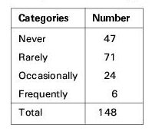
Ordinal Level Data
Frequencies and percentages can be computed for ordinal data
Examples: Likert Scales (Strongly Disagree to Strongly Agree); High School/Some College/College Graduate/Graduate School

Slide 6
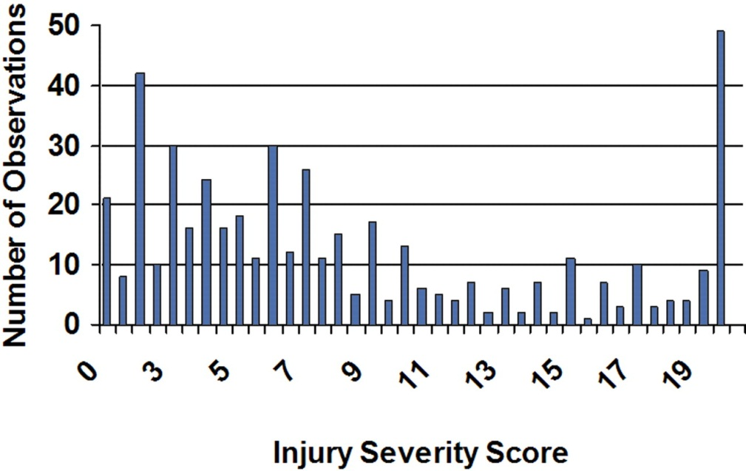
Interval/Ratio Data
We can compute frequencies and percentages for interval and ratio level data as well
Examples: Age, Temperature, Height, Weight, Many Clinical Serum Levels

Slide 7
Interval & Ratio Data
Measures of central tendency and measures of dispersion are often computed with interval/ratio data
Measures of Central Tendency (aka, the “Middle Point”)
Mean, Median, Mode
If your frequency distribution shows outliers, you might want to use the median instead of the mean
Measures of Dispersion (aka, How “spread out” the data are)
Variance, standard deviation, standard error of the mean
Describe how “spread out” a distribution of scores is
High numbers for variance and standard deviation may mean that scores are “all over the place” and do not necessarily fall close to the mean

Slide 8
INFERENTIAL STATISTICS
Inferential statistics can be used to:
prove or disprove theories,
determine associations between variables, and determine if findings are significant and
whether or not we can generalize from our sample to the entire population
Common types of inferential statistics
Correlation
T-tests/ANOVA
Chi-square
Logistic Regression

Slide 9
Type of Data & Inferential Analysis
Analysis of Categorical/Nominal Data
Correlation T-tests
T-tests
Analysis of Continuous Data
Chi-square
Logistic Regression

Slide 10
Correlation
When to use it?
When you want to know about the association or relationship between two continuous variables
Ex) food intake and weight; drug dosage and blood pressure; air temperature and metabolic rate, etc.
What does it tell you?
If a linear relationship exists between two variables, and how strong that relationship is
What do the results look like?
The correlation coefficient = Pearson’s r
Ranges from -1 to +1

Slide 11
Correlation
How do you interpret it?
If r is positive, high values of one variable are associated with high values of the other variable (both go in SAME direction - ↑↑ OR ↓↓)
Ex) Diastolic blood pressure tends to rise with age, thus the two variables are positively correlated
If r is negative, low values of one variable are associated with high values of the other variable (opposite direction - ↑↓ OR ↓ ↑)
Ex) Heart rate tends to be lower in persons who exercise frequently, the two variables correlate negatively
Correlation of 0 indicates NO linear relationship
How do you report it?
“Diastolic blood pressure was positively correlated with age (r = .75, p < . 05).”

Slide 12
T-tests
When to use them?
Paired t-tests: When comparing the MEANS of a continuous variable in two non-independent samples (i.e., measurements on the same people before and after a treatment)
Ex) Is diet X effective in lowering serum cholesterol levels in a sample of 12 people?
Ex) Do patients who receive drug X have lower blood pressure after treatment then they did before treatment?
Independent samples t-tests: To compare the MEANS of a continuous variable in TWO independent samples (i.e., two different groups of people)
Ex) Do people with diabetes have the same Systolic Blood Pressure as people without diabetes?

Slide 13
T-tests
What does a t-test tell you?
If there is a statistically significant difference between the mean score (or value) of two groups (either the same group of people before and after or two different groups of people)
What do the results look like?
Student’s t
How do you interpret it?
By looking at corresponding p-value
If p < .05, means are significantly different from each other
If p > 0.05, means are not significantly different from each other

Slide 14
Chi-square
When to use it?
When you want to know if there is an association between two categorical (nominal) variables (i.e., between an exposure and outcome)
Ex) Smoking (yes/no) and lung cancer (yes/no)
Ex) Obesity (yes/no) and diabetes (yes/no)
What does a chi-square test tell you?
If the observed frequencies of occurrence in each group are significantly different from expected frequencies (i.e., a difference of proportions)

Slide 15
Chi-square
What do the results look like?
Chi-square test statistics = X²
How do you interpret it?
Usually, the higher the chi-square statistic, the greater likelihood the finding is significant, but you must look at the corresponding p-value to determine significance

